Slide 1
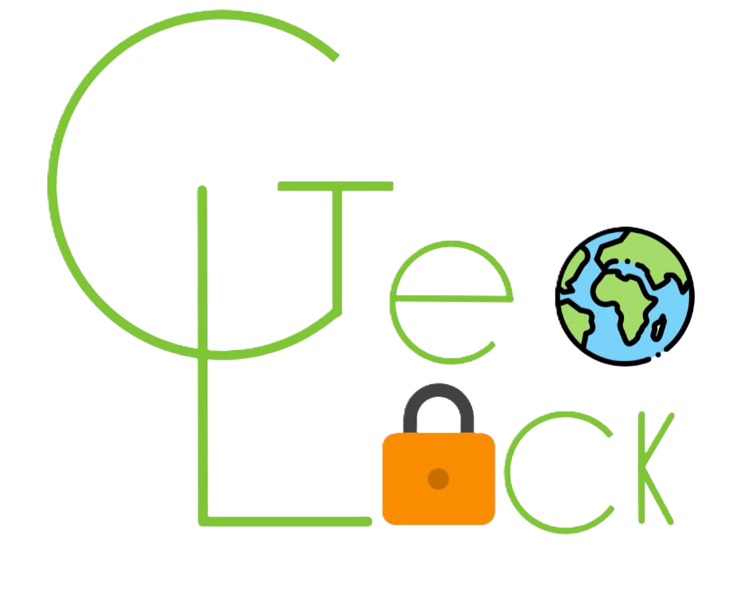
GeoLock
Alessio Tommasi (MSE) and Jonas Knupp (MAI)
Mobile and Wearable Computing
USI
Notes:
Alessio, 10s
welcome everyone, Today id like to introduce you to Geolock an app develop by me and Jonas during Mobile and Wearable Computing class.
..
Our app focuses on locking and unlocking messages based on GPS location. Specific people can view a particular message only if they are within a predefined range of a specific location.
Lets now move to the goal of our app:

Slide 2
Motivation
Nudge them to go outside
Increase curiosity of users
Discover hidden gems
Extensibility
Sensors
Camera
GPS
Notes:
Alessio 1.20
geolock
is designed to bring people closer
together by sharing string messages and images tied to
specific locations.
The goal of GeoLock is to make people more
aware of their surroundings and foster
connections with those nearby through the context
of their shared environment.

Slide 3
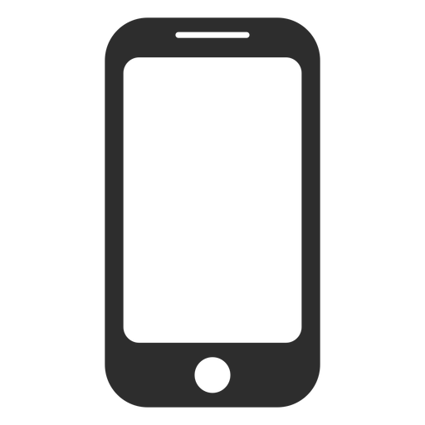
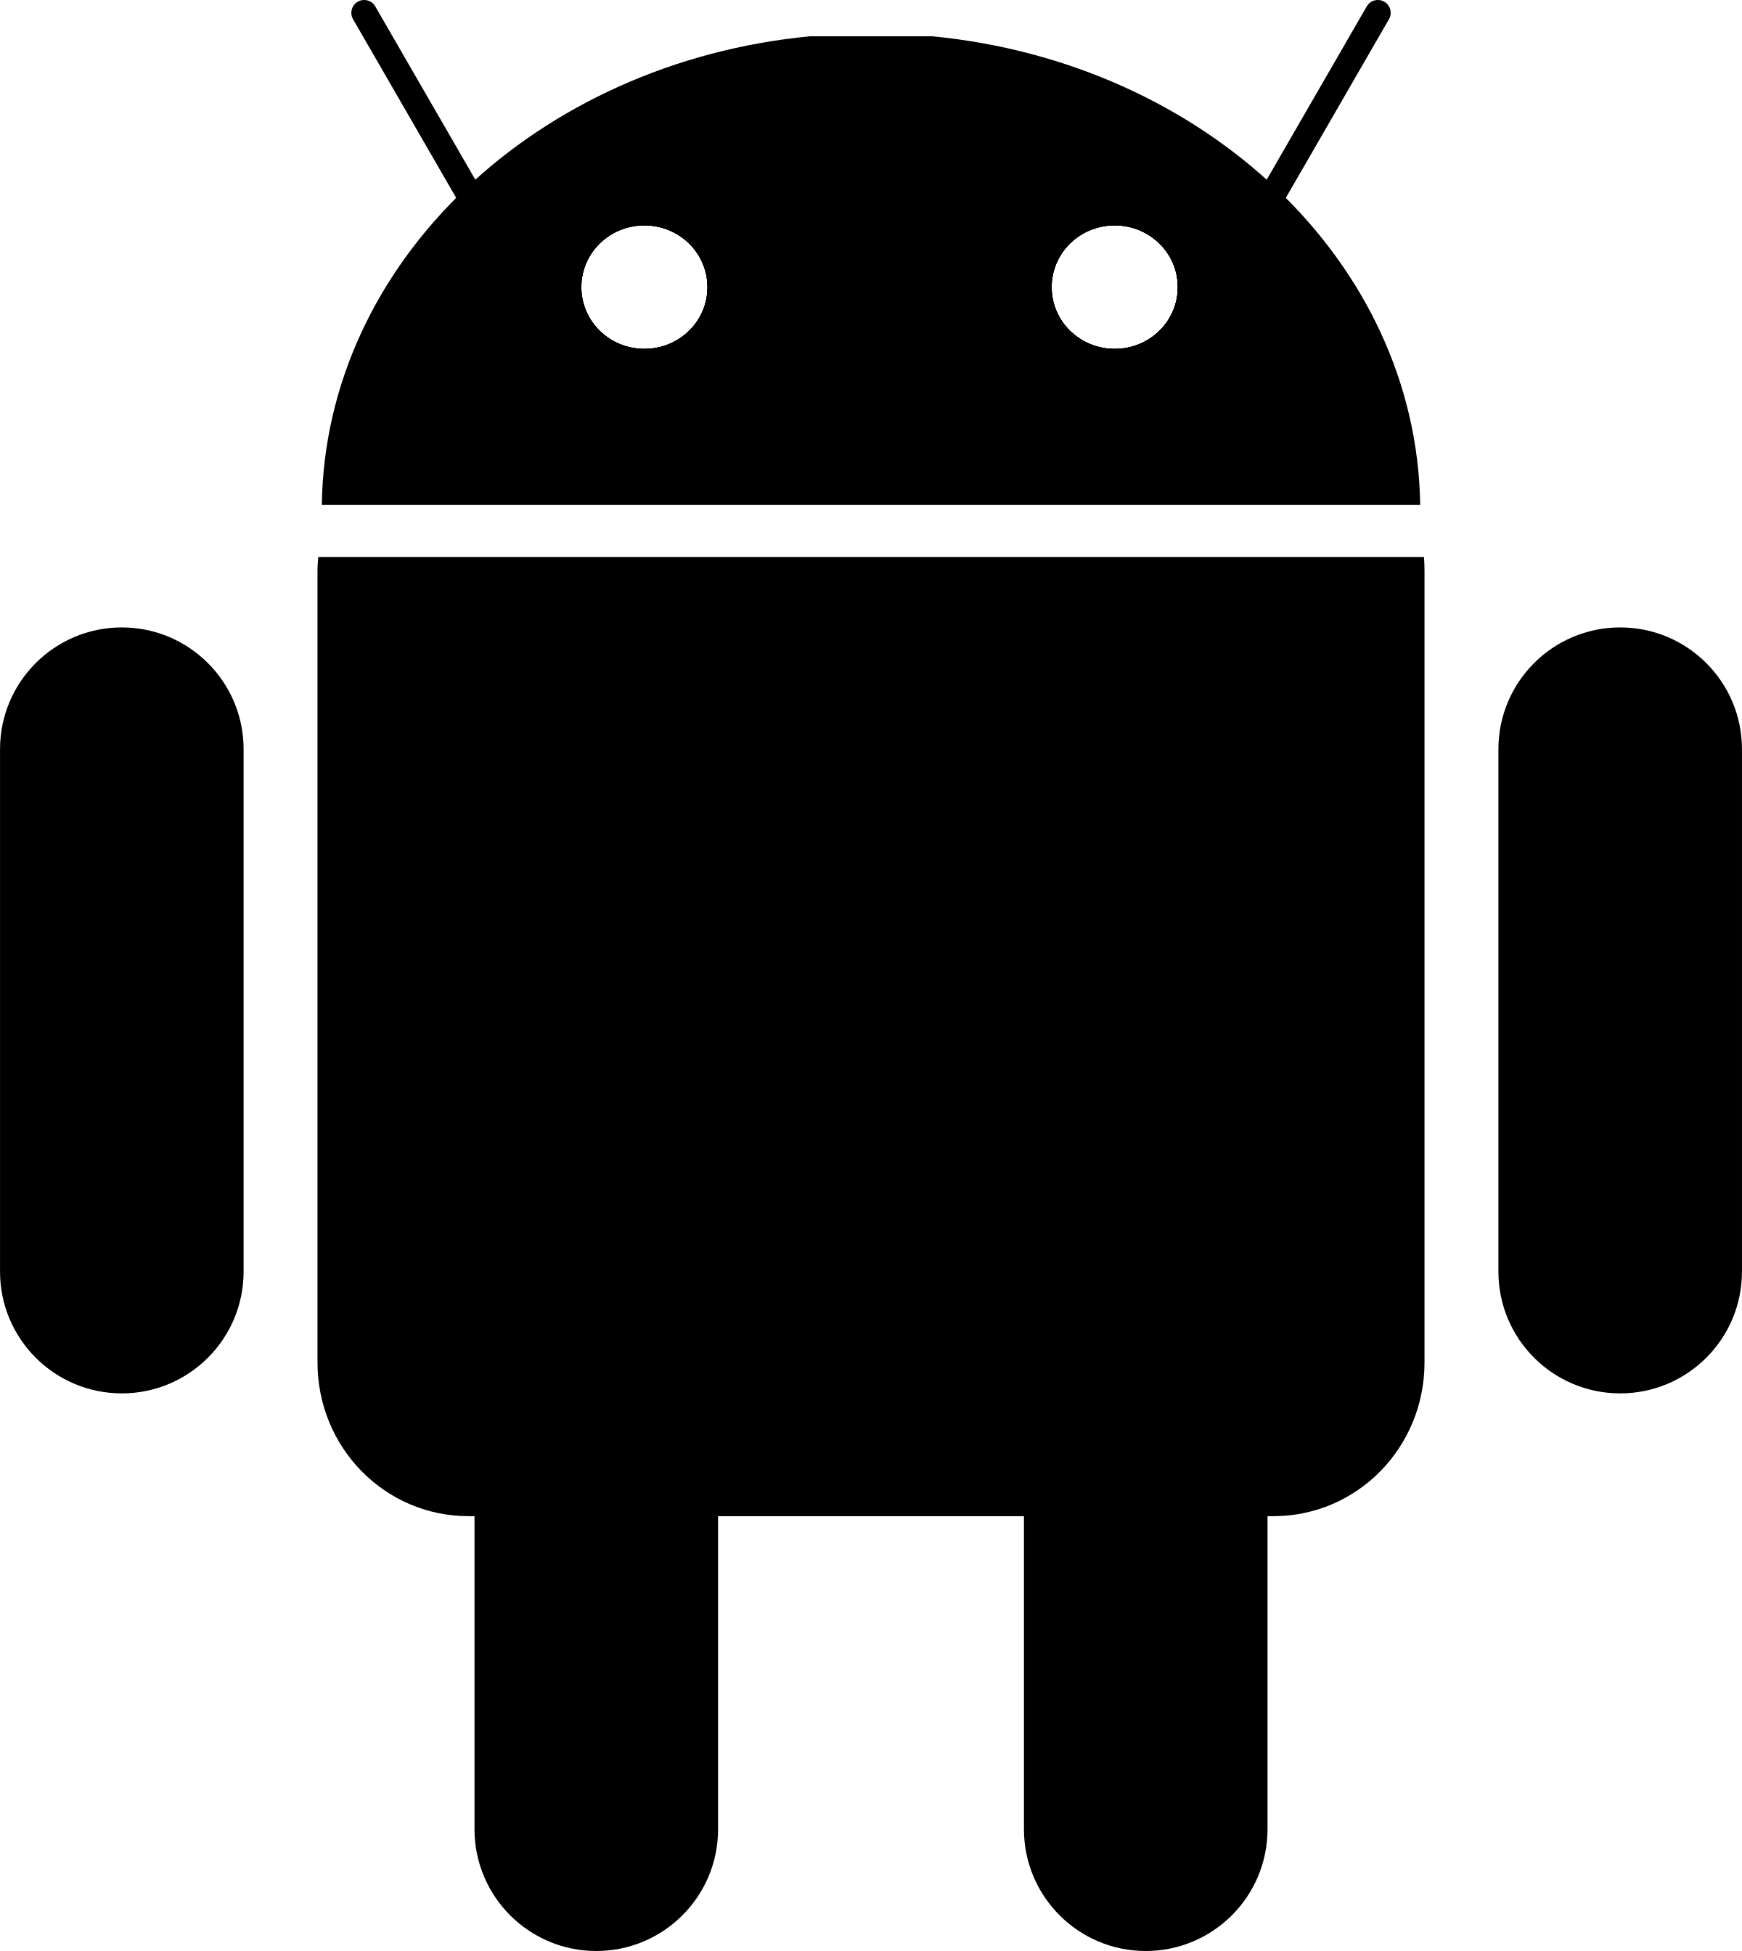
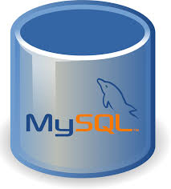
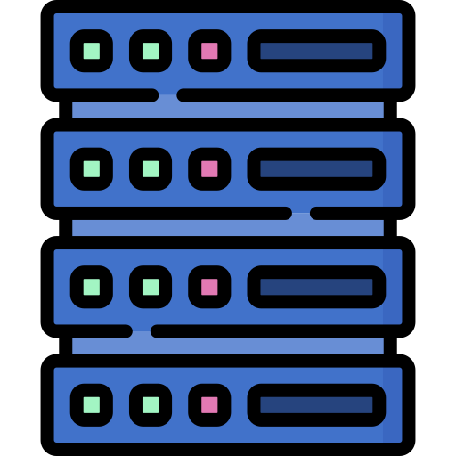
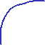
Implementation: Architecture
Classical client-server model
Data is exchanged as JSON
Strong focus on Android app
Relational database
Android clients
Single-activity architecture
Material Design
Web API
PHP-Backend
Notes:
Alessio, 30
Here i have shown a quick overview of the architecture, which is based on a
classical client-server model but i skip on other technical.
for meet time requrement so pass though the next side that focus on the UI of geolock.
I will use the term ‘fragment’ to refer to the displayed page that the user sees
The system works by exchanging data in JSON format, ensuring smooth and
efficient communication.
On the backend, we use a relational database and PHP to manage and store all
the data.
In the image, you can see how everything connects: the Android clients
communicate with the system through a web API, which acts as a bridge between
the app and the backend.
For handling network requests, we rely on Retrofit, a library that ensures smooth
and efficient data exchange.
Now I will introduce you in the Ui of Geo lock:
In the next slide,

Slide 4
Implementation: MapFragment
Green marker: unlocked spot
Red marker: locked spot
Circles: unlock area
Notes:
Alessio
As we can see here, we have the main screen with some markers.
These markers represent the messages that someone has left here.
We can see that the unlocked ones are marked in green, while the locked ones are in red.
I want you to focus on the dashed line near the marker that represents the unlocked area.
Here in white, we can see our current location, faked by the emulator,
which is near in the unlocked green marker and inside the dash lined area as expected.

Slide 5
Implementation: AddFragment
Simple form to add a spot
Input validation
Notes:
Jonas, 45s
The AddFragment allows users to create a new spot at their current location.
The user provides an image and a message.
Furthermore, the user can define how close people must be to unlock the spot and when the spot expires.

Slide 6
Implementation NearFragment
Shows nearby spots in a list
Sortable by distance to spot
Clicking on a spot opens MapFragment centered on the choosen spot
Notes:
Jonas
In the NearFragment all spots are displayed in a list.
The underlying data is the same as in the MapFragment but sometimes it is easier to see the data in a list form.
The list can be filtered such that spots that are further away than 100km are removed.
It is also possible to sort the spots by distance.

Slide 7
Learnings
Modern SE tools allow for rapid prototyping
Docker, OpenAPI, Android Studio (incl. emulator), Material Design
Efficient implementation is crucial on mobile devices
Often neglected nowadays due to processors being so fast
Notes:
Jonas, 30s

Slide 8
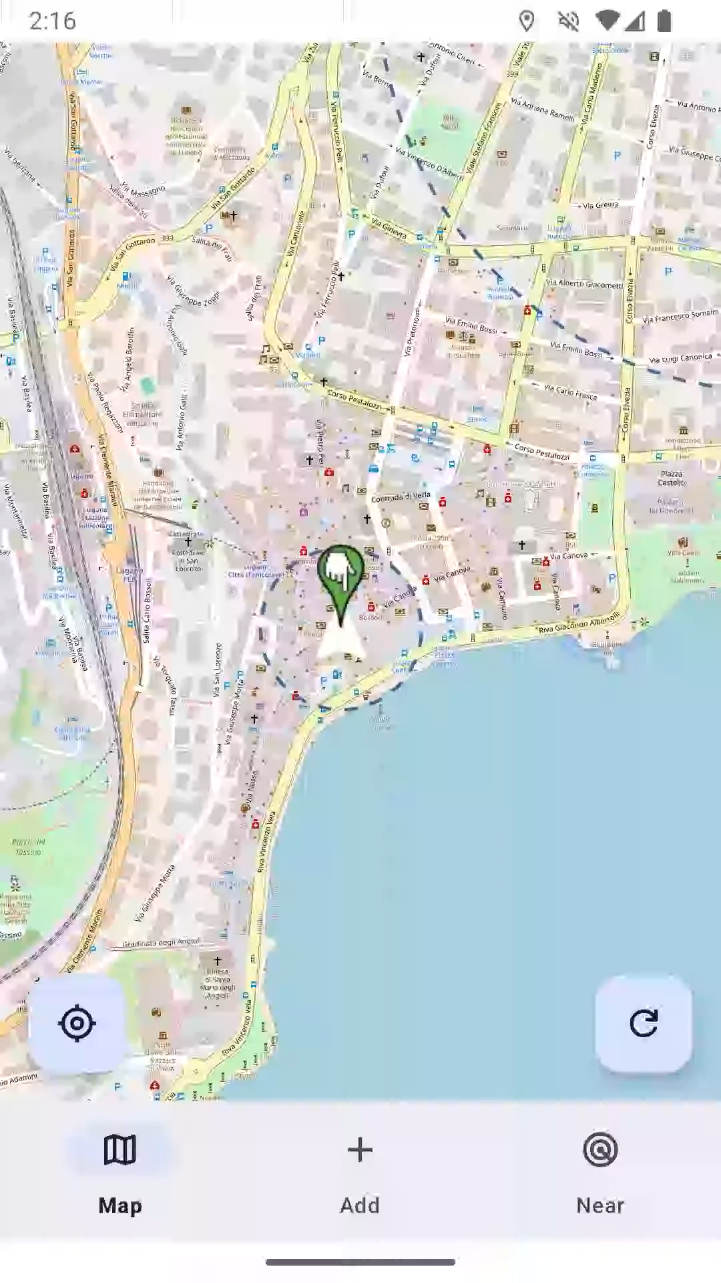
Demo
Notes:
Jonas, 1m30s
We prepared a brief video that shows our app in action.
In reality you also need to take an image but that is not possible with the emulator so we skip it. Now we move over to the NearFragment.
That’s our app. Thanks for you attention.

